Slide 1
E-COMMERCE (ECM-133)
BIT (Third Semester) – Texas College

Slide 2
UNIT IV E-COMMERCE IN ACTION
Chapter 9: Online Retail and Services
Chapter 10: Online Content and Media
Chapter 11: Social Networks, Auctions, and Portals
Chapter 12: B2B E-commerce: Supply Chain Management and Collaborative Commerce

Slide 3
UNIT IV E-COMMERCE IN ACTION
Chapter 9: Online Retail and Services

Slide 4
ONLINE RETAIL AND SERVICES
The most important theme in online retailing is the effort by retailers—both offline and online—to integrate their operations so they can serve customers in the various ways they want to be served
The Retail Industry
The retail industry is composed of many different types of firms. Figure 9.1 divides the retail industry into seven segments: durable goods, general merchandise, food and beverage, specialty stores, gasoline and fuel, mail order/telephone order (MOTO), and online retail firms. Each of these segments offers opportunities for online retail, and yet in each segment, the uses of the Internet may differ.

Slide 5
ONLINE RETAIL AND SERVICES – RETAIL INDUSTRY
Some eating and drinking establishments use the Web to inform people of their physical locations and menus, while others offer delivery via Web orders (although this has not been a successful model).
Retailers of durable goods typically use the Web primarily as an informational tool rather than as a direct purchasing tool, although this has begun to change

Slide 6
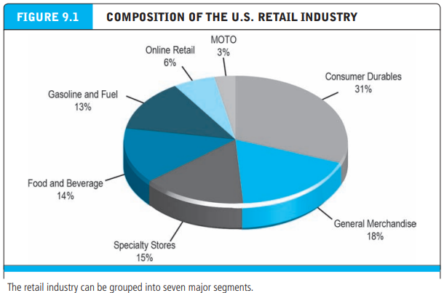
ONLINE RETAIL AND SERVICES – RETAIL INDUSTRY

Slide 7
ONLINE RETAIL AND SERVICES
Online retail is perhaps the most high-profile e-commerce sector. Over the past decade, this sector has experienced both explosive growth and spectacular failures. Many of the early pure-play online-only firms that pioneered the retail marketspace failed.
Entrepreneurs and their investors seriously misjudged the factors needed to succeed in this market. But the survivors of this early period emerged much stronger, and along with traditional offline general and specialty merchants, as well as new start-ups, the e-tail space is growing very rapidly and is increasing its reach and size.

Slide 8
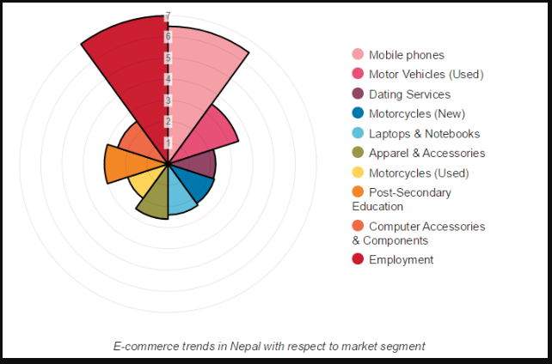
ONLINE RETAIL AND SERVICES – ONLINE RETAILING

Slide 9
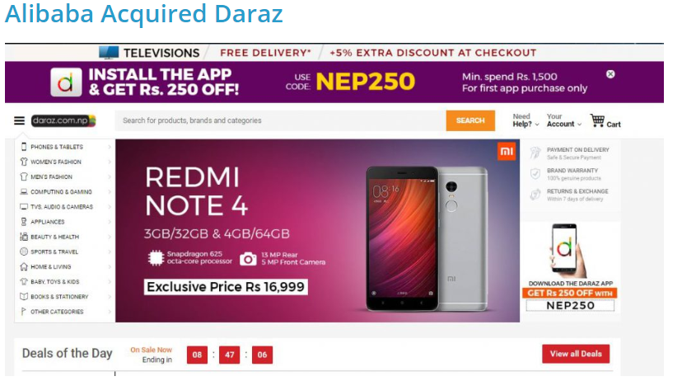
Top online shopping portals acquired recently in 2018
Daraz, which was a child company of Rocket Internet was acquired by Alibaba recently this year in May. Founded in 2012, Daraz operated its E-commerce business chain in south Asian countries like Pakistan, Sri Lanka, Nepal, Bangladesh & Myanmar. However, it was operated in Nepal in January 2013 as Kaymu. Later, it rebranded as Daraz and sold various products under different categories online with free/paid delivery.

Slide 10
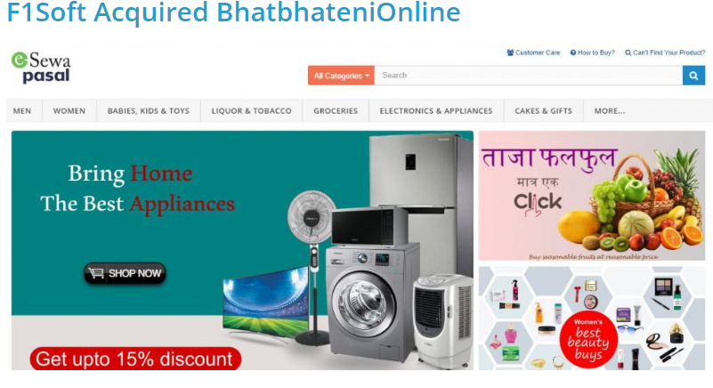
Top online shopping portals acquired recently in 2018
One of largest financial technology company of Nepal, F1Soft acquired BhatbhateniOnline in June 2018. BhatbhateniOnline has been operating its online business for past 6 years and managed to earn a decent trust & credibility in the Nepali market.
F1Soft, which is a tech giant in Nepal has stepped into E-commerce business in Nepal with this acquisition. They have rebranded BhatbhateniOnline as eSewapasal. However, Both the portals have different websites for now. It would be interesting to see if they combine them into one or just operate them separately..

Slide 11
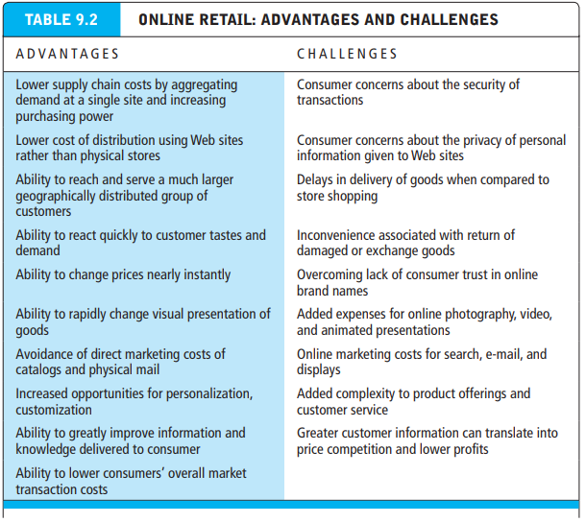
ONLINE RETAIL : ADVANTAGES AND CHALLANGES

Slide 12
ONLINE RETAIL : MULTI-CHANNEL INTEGRATION
Clearly one of the most important e-commerce retail themes of 2013–2014, and into the future, is the ability of offline traditional firms such as Walmart, Target, JCPenney, Staples, and others to continue to integrate their Web and mobile operations with their physical store operations in order to provide an “integrated shopping customer experience,” and leverage the value of their physical stores

Slide 13
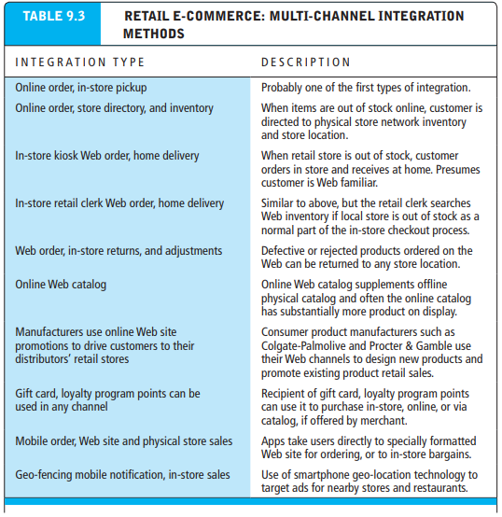
ONLINE RETAIL : MULTI-CHANNEL INTEGRATION

Slide 14
ANALYZING THE VIABILITY OF ONLINE FIRMS
Moving On, we will analyze the viability of a number of online companies that exemplify specific e-commerce models.
We are primarily interested in understanding the near-to-medium term (1–3 years) economic viability of these firms and their business models.
Economic viability refers to the ability of firms to survive as profitable business firms during the specified period. To answer the question of economic viability, two business analysis approaches: strategic analysis and financial analysis can be applied

Slide 15
STRATEGIC ANALYSIS AND FACTORS
Strategic approaches to economic viability focus on both the industry in which a firm operates and the firm itself (see Chapter 2, Sections 2.2 and 2.5). The key industry strategic factors are:
Barriers to entry: Can new entrants be barred from entering the industry through high capital costs or intellectual property barriers (such as patents and copyrights)?
Power of suppliers: Can suppliers dictate high prices to the industry or can vendors choose from among many suppliers? Have firms achieved sufficient scale to bargain effectively for lower prices from suppliers?
Power of customers: Can customers choose from many competing suppliers and hence challenge high prices and high margins?

Slide 16
STRATEGIC ANALYSIS AND FACTORS
Existence of substitute products: Can the functionality of the product or service be obtained from alternative channels or competing products in different industries? Are substitute products and services likely to emerge in the near future?
Industry value chain: Is the chain of production and distribution in the industry changing in ways that benefit or harm the firm?
Nature of intra-industry competition: Is the basis of competition within the industry based on differentiated products and services, price, scope of offerings, or focus of offerings? How is the nature of competition changing? Will these changes benefit the firm?

Slide 17
FINANCIAL ANALYSIS
Strategic analysis helps us comprehend the competitive situation of the firm. Financial analysis helps us understand how in fact the firm is performing.
There are two parts to a financial analysis: the statement of operations and the balance sheet.
The statement of operations tells us how much money (or loss) the firm is achieving based on current sales and costs.
The balance sheet tells us how many assets the firm has to support its current and future operations.

Slide 18
FINANCIAL ANALYSIS – FIRMS STATEMENT OF OPERATION
Some of the key factors to look for in a firm’s statement of operations:
Revenues: Are revenues growing and at what rate? Many e-commerce companies have experienced impressive, even explosive, revenue growth as an entirely new channel is created.
Cost of sales: What is the cost of sales compared to revenues? Cost of sales typically includes the cost of the products sold and related costs. The lower the cost of sales compared to revenue, the higher the gross profit.

Slide 19
FINANCIAL ANALYSIS – FIRMS STATEMENT OF OPERATION
Gross margin: What is the firm’s gross margin, and is it increasing or decreasing? Gross margin is calculated by dividing gross profit by net sales revenues. Gross margin can tell you if the firm is gaining or losing market power vis-à-vis its key suppliers
Operating expenses: What are the firm’s operating expenses, and are they increasing or decreasing? Operating expenses typically include the cost of marketing, technology, and administrative overhead
Operating margin: What did the firm earn from its current operations? Operating margin is calculated by dividing operating income or loss by net sales revenue. Operating margin is an indication of a company’s ability to turn sales into pre-tax profit after operating expenses have been deducted

Slide 20
FINANCIAL ANALYSIS – FIRMS STATEMENT OF OPERATION
Net margin: Net margin tells us the percentage of its gross sales revenue the firm was able to retain after all expenses are deducted. Net margin is calculated by dividing net income or loss by net sales revenue. Net margin sums up in one number how successful a company has been at the business of making a profit on each dollar of sales revenues.
Net margin also tells us something about the efficiency of the firm by measuring the percentage of sales revenue it is able to retain after all expenses are deducted from gross revenues, and within a single industry can be used to measure the relative efficiency of competing firms

Slide 21
E-TAILING BUSINESS MODELS
Multi-channel Merchants: Bricks-and-clicks
bricks-and-clicks companies that have a network of physical stores as their primary retail channel, but have also introduced online offerings.
Also called multi-channel merchants, bricks-and-clicks companies have a network of physical stores as their primary retail channel, but have also introduced online offerings. These are multi-channel firms such as Walmart, Macy’s, Sears, JCPenney, Staples, OfficeMax, Costco, Target, and other brand-name merchants. While bricksand-clicks merchants face high costs of physical buildings and large sales staffs, they also have many advantages such as a brand name, a national customer base, warehouses, large scale (giving them leverage with suppliers), and a trained staff.
Acquiring customers is less expensive because of their brand names, but these firms face challenges in coordinating prices across channels and handling returns of Web purchases at their retail outlets

Slide 22
E-TAILING BUSINESS MODELS
Catalog merchants established companies that have a national offline catalog operation that is their largest retail channel, but who have recently developed online capabilities
Catalog merchants such as Lands’ End, L.L.Bean, CDW Corp., PC Connection, Cabela’s, and Victoria’s Secret are established companies that have a national offline catalog operation, but who have also developed online capabilities. Catalog merchants face very high costs for printing and mailing millions of catalogs each year—many of which have a half-life of 30 seconds after the customer receives them. Catalog merchants typically have developed centralized fulfillment and call centers, extraordinary service, and excellent fulfillment in partnership with package delivery firms such as FedEx and UPS

Slide 23
E-TAILING BUSINESS MODELS
Manufacturer-direct firms are either single- or multi-channel manufacturers that sell directly online to consumers without the intervention of retailers. Manufacturer-direct firms were predicted to play a very large role in e-commerce, but this has generally not happened. The primary exceptions are computer hardware, where firms such as Apple, Dell, Sony, and Hewlett-Packard account for over 70% of computer retail sales online, and apparel manufacturers, such as Ralph Lauren, Nike, Under Armour, Fossil, Crocs, Jones Retail, and Vera Bradley

Slide 24
E-TAILING BUSINESS MODELS
Manufacturer-direct firms sometimes face channel conflict challenges:
Channel conflict occurs when retailers of products must compete on price and currency of inventory directly against the manufacturers
Supply-push model products are made prior to orders received based on estimated demand
Demand-pull model products are not built until an order is received

Slide 25
THE SERVICE SECTOR : ONLINE AND OFFLINE
The service sector is typically the largest and most rapidly expanding part of the economies in advanced industrial nations such as the United States, and many European and some Asian countries
The major service industry groups are finance, insurance, real estate, travel, professional services such as legal and accounting, business services, health services, and educational services. Business services include activities such as consulting, advertising and marketing, and information processing. Within these service industry groups, companies can be further categorized into those that involve transaction brokering (acting as an intermediary to facilitate a transaction) and those that involve providing a “hands-on” service

Slide 26
THE SERVICE SECTOR : ONLINE AND OFFLINE
For instance, one type of financial service involves stockbrokers who act as the middle person in a transaction between buyers and sellers. Online mortgage companies such as LendingTree.com refer customers to mortgage companies that actually issue the mortgage. Employment agencies put a seller of labor in contact with a buyer of labor. The service involved in all these examples is brokering a transaction.
In contrast, some industries perform specific hands-on activities for consumers. In order to provide their service, these professionals need to interact directly and personally with the “client.” For these service industries, the opportunities for e-commerce are somewhat different. Currently, doctors and dentists cannot treat patients over the Internet. However, the Internet can assist their services by providing consumers with information, knowledge, and communication

Slide 27
THE SERVICE SECTOR : ONLINE AND OFFLINE
Examples of Online Service sector in Nepal
Finance – Banking / Finance (E.g. NIBL, Standard Chartered etc)
Insurance - http://www.ebeema.com/
Real Estate - www.1ropani.com/ https://www.gharjagganepal.com/ www.therealtors.com.np/
Travel - http://mytrip2nepal.com/
Professional Service - https://www.ican.org.np/
Business Service - https://www.export.gov
Health Service - https://www.hamrodoctor.com/
Educational Service - https://kullabs.com
Career Service - https://www.jobsnepal.com

Slide 28
UNIT IV : E-COMMERCE IN ACTION
Chapter 10: Online Content and Media

Slide 29
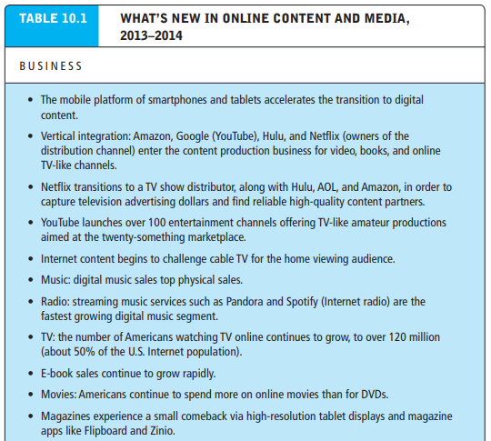
Online Content and Media – Recent Trends

Slide 30
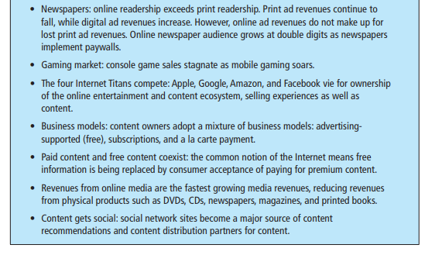
Online Content and Media – Recent Trends

Slide 31
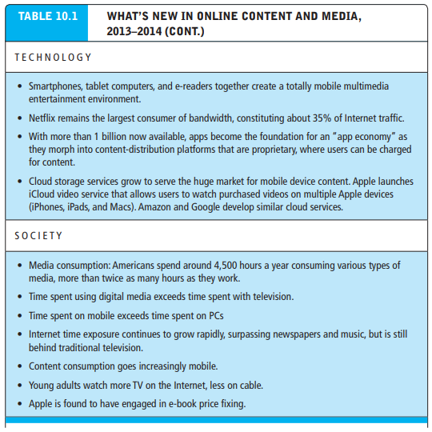
Online Content and Media – Recent Trends

Slide 32
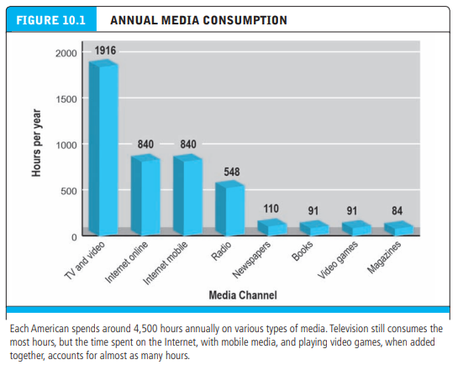
Content Audience and Market: Where Are the Eyeballs and the Money?

Slide 33
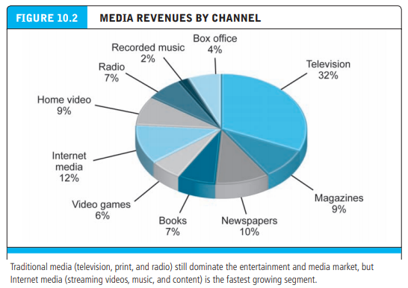
Content Audience and Market: Where Are the Eyeballs and the Money?

Slide 34
THREE REVENUE MODELS FOR DIGITAL CONTENT DELIVERY
There are three revenue models for delivering content on the Internet
The two “pay” models are subscriptions (usually “all you can eat”) and a la carte (pay for what you use)
The third model uses advertising revenue to provide content for free, usually with a “freemium” (higher price) option
Contrary to early analysts’ projections that “free” would drive “paid” out of business (“information wants to be free”), it turns out that both models are viable now and in the near future. Consumers increasingly choose to pay for high-quality, convenient, and unique content, and they have gladly accepted “free” advertiser-supported content when that content is deemed not worth paying for but entertaining nevertheless

Slide 35
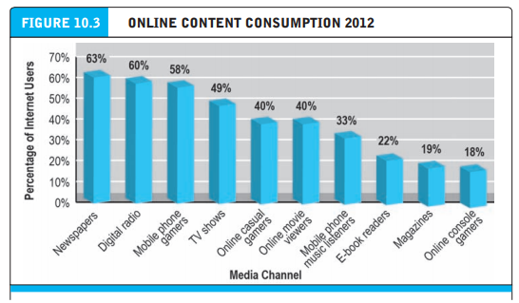
ONLINE CONTENT CONSUMPTION

Slide 36
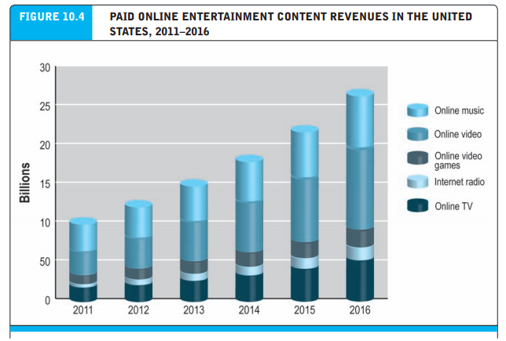
PAID ONLINE ENTERTAINMENT CONTENT REVENUES

Slide 37
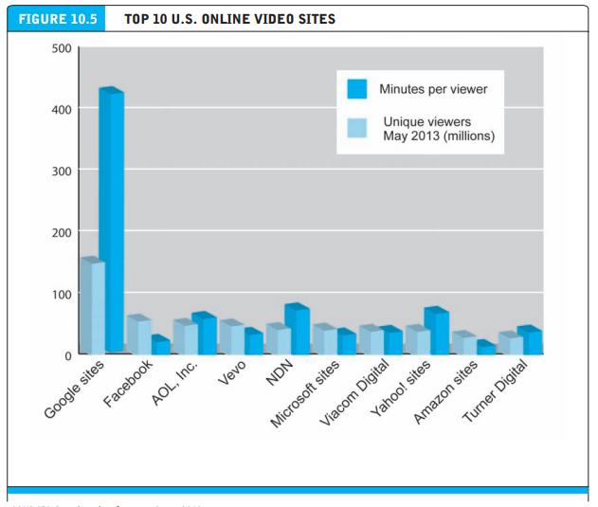
TOP ONLINE VIDEO SITES

Slide 38
Digital Rights Management (DRM) and Walled Gardens
Content producers—newspapers, book publishers, television, movie, and music producers—generate revenue and profits from their creations, and they protect these revenue streams through copyright.
Created by Congress in Article I, Section 8 of the United States Constitution, Congress granted authors and inventors copyrights and patent rights to “the progress of science and useful arts.”
The first Copyright Act was passed in 1790. In the digital age, when exact copies and widescale distribution of works are possible, protecting the copyrights to content is a major challenge

Slide 39
Digital Rights Management (DRM) and Walled Gardens
Digital rights management (DRM) refers to a combination of technical (both hardware and software) and legal means for protecting digital content from unlimited reproduction and distribution without permission. Essentially, DRM can prevent users from purchasing and making copies for widespread distribution over the Internet without compensating the content owners. While music tracks in the iTunes Store were originally protected by DRM, in 2009, Apple abandoned the practice because of user objections, and because Amazon had opened an online music store in 2007 without any DRM protections, with the support of music label firms, who came to realize that DRM prevented them from exploiting the opportunities of the Internet and perhaps encouraged an illegal market

Slide 40
Media Convergence: Technology, Content, and Industry Structure
Technological convergence: development of hybrid devices that can combine the functionality of two or more existing media platforms into a single device
Content convergence: convergence in the design, production, and distribution of content
Industry convergence: merger of media enterprises into synergistic combinations that create and cross-market content on different platforms

Slide 41
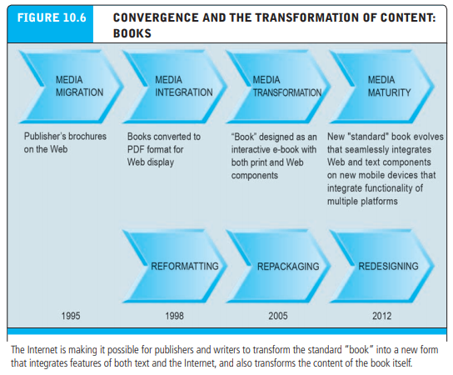
CONVERGENCE AND TRANSFORMATION OF CONTENT: BOOKS

Slide 42
The Online Publishing Industry
Nothing is quite so fundamental to a civilized society as reading text. Text is the way we record our history, current events, thoughts, and aspirations, and transmit them to all others in the civilization who can read. Even television shows and movies require scripts. Today, the publishing industry (composed of books, newspapers, magazines, and periodicals) is a $92 billion media sector based originally on print, and now moving rapidly to the Internet.
The Internet offers the text publishing industry an opportunity to move toward a new generation of newspapers, magazines, and books that are produced, processed, stored, distributed, and sold over the Web, available anytime, anywhere, and on any device. The same Internet offers the possibility of destroying many existing print-based businesses that may not be able to make this transition and remain profitable

Slide 43
Online Newspapers
Newspapers in 2013 are the most troubled segment of the publishing industry, troubles that result almost exclusively from the availability of alternatives to the printed newspaper, as well as a sluggish response by management to the opportunities on the Internet for news, if not newspapers. Also important is the failure of newspaper management to protect its valuable content from being distributed for free by headline aggregators such as Yahoo, MSN, and Google, as well as tens of millions of bloggers and tweeters

Slide 44
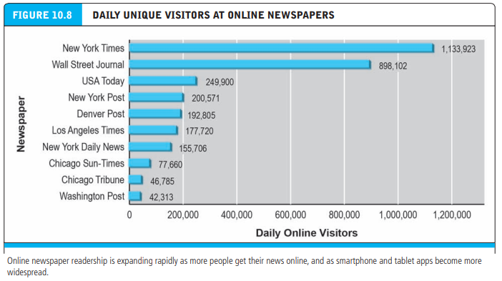
Audience Size and Growth

Slide 45
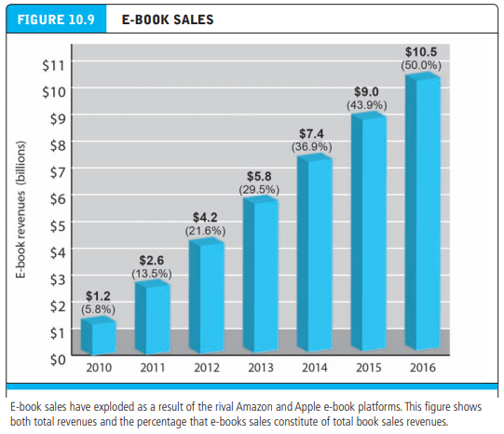
E-Books and Online Book Publishing

Slide 46
Amazon and Apple: The New Digital Media Ecosystems
Prospects for e-books picked up in 2001 with the introduction of Apple’s iPod, which later became a platform for e-books (iPod Touch). In 2004, Sony introduced the first e-ink reader (Sony Librie). In 2007, the iPhone smartphone was released with a high definition color screen that could be used to read books.
The future of e-books was finally and firmly established when Amazon introduced its Kindle in 2007 to a skeptical public and critical industry observers. The early Kindle readers used electronic ink technology, providing a higher resolution than PCs and a longer battery life than portable book readers. The early Kindle had 16 megabytes of memory and could store 200 books. More important, the reader was linked to the Internet through AT&T’s cell network, permitting users to access Amazon’s bookstore where they could browse, search, and purchase e-books

Slide 47
What Are the Challenges of the Digital E-Book Platform?
Despite, or because, of the rapid growth in e-books, the book publishing industry is in stable, even robust condition. There are two major challenges facing book publishers. Responses to these challenges will shape the future existence of the book publishing industry as we know it. These two challenges are cannibalization and finding the right business model.
Cannibalization when sales of new digital products replace sales of traditional products

Slide 48
E-Book Business Models
The e-book industry is composed of intermediary retailers (both brick-and-mortar stores and online merchants), traditional publishers, technology developers, device makers (e-readers), and vanity presses (self-publishing service companies). Together, these players have pursued a wide variety of business models and developed many alliances in an effort to move text onto the computer screen
There are six very large publishers that dominate trade book, education, and religious book publishing. These traditional publishers have the largest content libraries for conversion to e-books. These large publishers started out using a wholesale model of distribution and pricing, in part because this is the same model they used with hard cover books. wholesale model: prices are determined by the retailer
Agency model the retailer is an agent and prices are set by the manufacturer

Slide 49
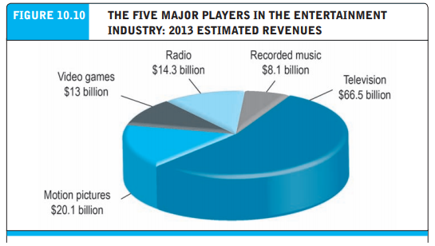
The Online entertainment industry
The entertainment industry is generally considered to be composed of four traditional, commercial players and one new arrival: television, radio broadcasting, films, music, and video games (the new arrival)

Slide 50
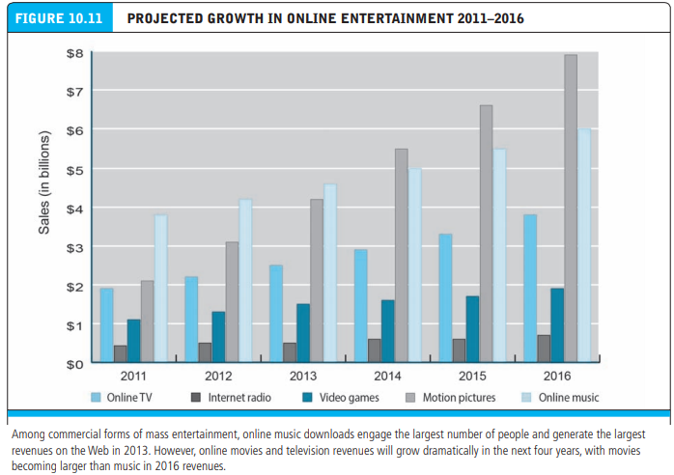
Online Entertainment Audience Size and Growth

Slide 51
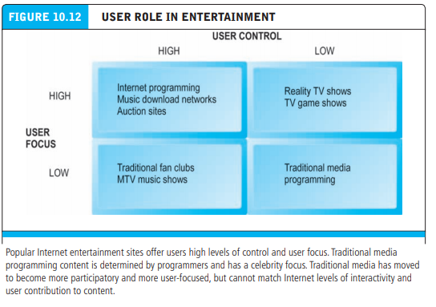
Users role in entertainment

Slide 52
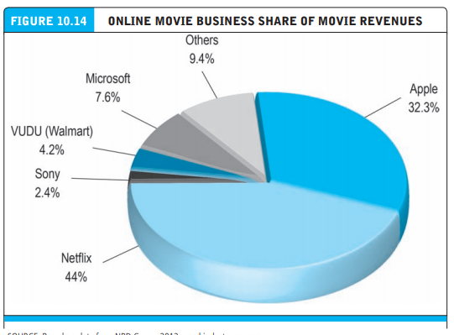
Movie business share

Slide 53
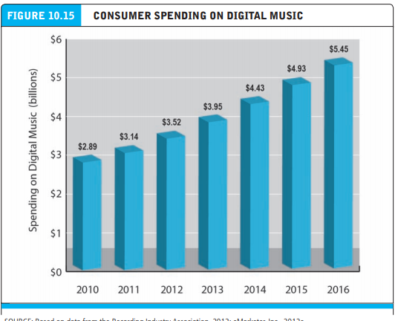
CONSUMER SPENDING ON MUSIC

Slide 54
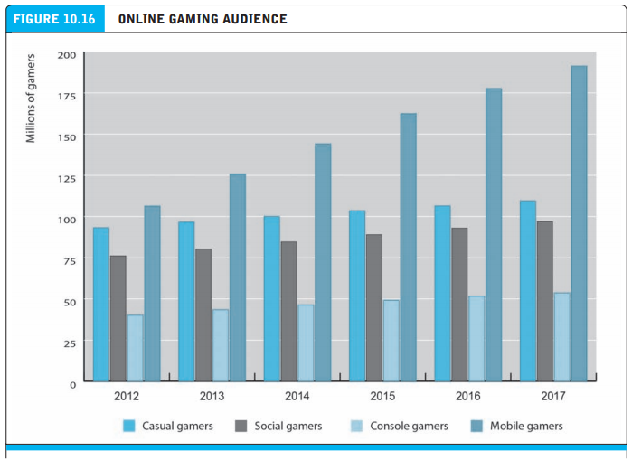
CONSUMER SPENDING ON GAMES

Slide 55
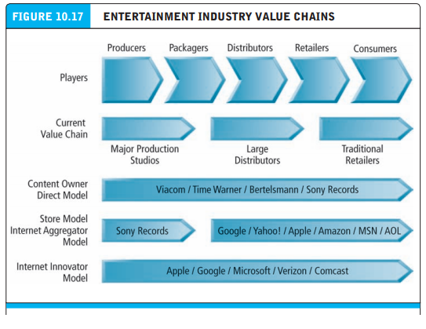
ENTERTAINMENT INDUSTRY VALUE CHAINS

Slide 56
UNIT IV : E-COMMERCE IN ACTION
Chapter 11: Social networks, auctions, and portals

Slide 57
Social networks, auctions, and portals
Social network involves a group of people, shared social interaction, common ties among members, and people who share an area for some period of time. Social networks do not necessarily have shared goals, purposes, or intentions. Indeed, social networks can be places where people just “hang out,” share space, and communicate
Online social network an area online, where people who share common ties can interact with one another

Slide 58
Difference Between Social Networks and Portals
Portals began as search engines and then added content, Internet, and e-commerce services. In order to survive, portals have added many community-building and social network features, such as chat groups, bulletin boards, and free Web site design and hosting, that encourage visitors to stay on the site and interact with others who share their interests. Yahoo, for instance, uses deep vertical content features to retain its audience on-site and maximize revenue opportunities. Portals have begun to measure their success in terms of their social network features

Slide 59
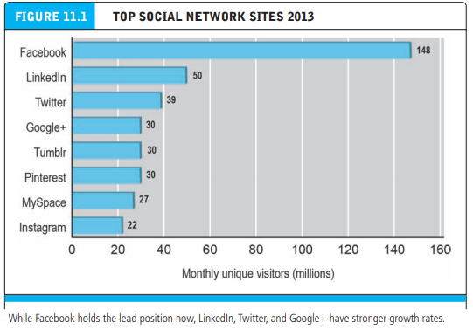
Difference Between Social Networks and Portals

Slide 60
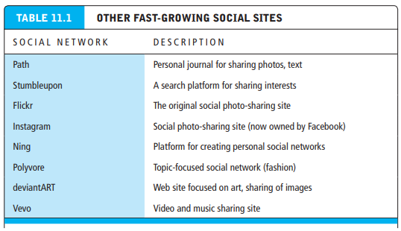
Other social sites

Slide 61
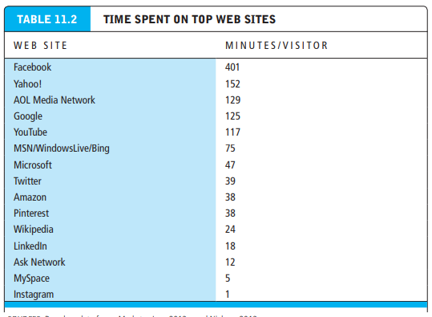
Time spent on top websites

Slide 62
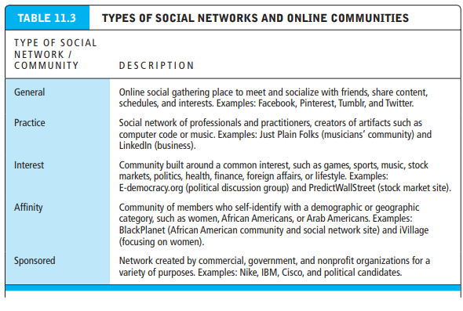
Types of social networks and communities

Slide 63
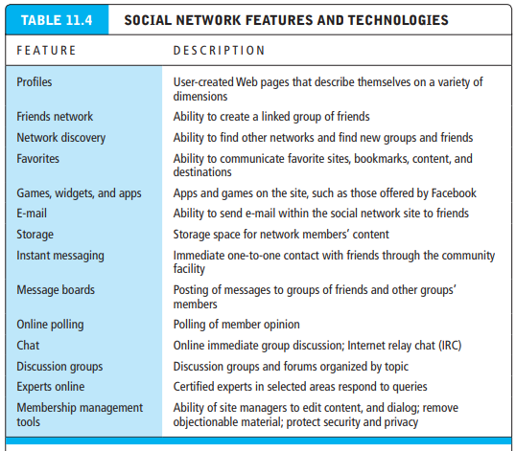
Social network features and technologies

Slide 64
Online Auctions
Auctions markets in which prices are variable and based on the competition among participants who are buying or selling products and services
Online auction sites are among the most popular consumer-to-consumer (C2C) e-commerce sites on the Internet, although the popularity of auctions and their growth rates have slowed in recent years due to customers’ preferences for a “buy now” fixedprice model. The market leader in C2C auctions is eBay, which has 130 million active users in the United States and over 350 million items listed on any given day within 18,000 categories

Slide 65
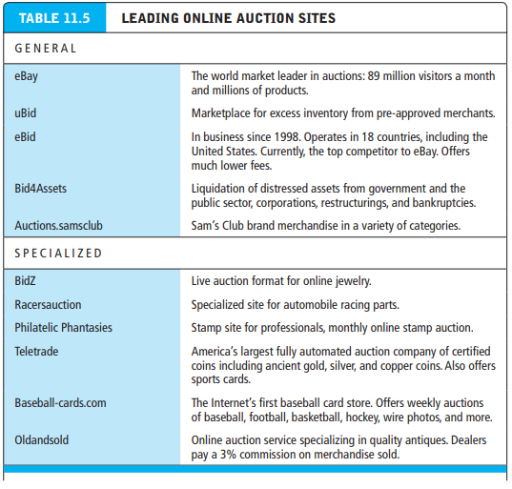
Online Auctions

Slide 66
Why Are Auctions So Popular? Benefits and Costs of Auctions
The Internet is primarily responsible for the resurgence in auctions. Although electronic network-based auctions such as AUCNET in Japan (an electronic automobile auction for used cars) were developed in the late 1980s, these pre-Internet auctions required an expensive telecommunications network to implement. The Internet provides a global environment and very low fixed and operational costs for the aggregation of huge buyer audiences, composed of millions of consumers worldwide, who can use a universally available technology (Internet browsers) to shop for goods

Slide 67
Why Are Auctions So Popular? Benefits and Costs of Auctions
Benefits of Auctions
Aside from the sheer game-like fun of participating in auctions, consumers, merchants, and society as a whole derive a number of economic benefits from participating in Internet auctions. These benefits include:
Liquidity: Sellers can find willing buyers, and buyers can find sellers. The Internet enormously increased the liquidity of traditional auctions that usually required all participants to be present in a single room. Now, sellers and buyers can be located anywhere around the globe. Just as important, buyers and sellers can find a global market for rare items that would not have existed before the Internet

Slide 68
Why Are Auctions So Popular? Benefits and Costs of Auctions
Price discovery: Buyers and sellers can quickly and efficiently develop prices for items that are difficult to assess, where the price depends on demand and supply, and where the product is rare. For instance, how could a merchant (or buyer) price a Greek oil lamp made in 550 B.C. (to use just one example of the rare items that can be found on eBay)? How could a consumer even find a Greek oil lamp without the Internet? It would be difficult and costly for all parties
Price transparency: Public Internet auctions allow everyone in the world to see the asking and bidding prices for items. It is difficult for merchants to engage in price discrimination (charging some customers more) when the items are available on auctions. However, because even huge auction sites such as eBay do not include all the world’s online auction items (there are other auction sites in the world), there still may be more than one world price for a given item (there are inter-market price differences)

Slide 69
Why Are Auctions So Popular? Benefits and Costs of Auctions
Market efficiency: Auctions can, and often do, lead to reduced prices, and hence reduced profits for merchants, leading to an increase in consumer welfare—one measure of market efficiency. Online auctions provide consumers the chance to find real bargains at potentially give-away prices; they also provide access to a very wide selection of goods that would be impossible for consumers to access physically by visiting stores.
Lower transaction costs: Online auctions can lower the cost of selling and purchasing products, benefiting both merchants and consumers. Like other Internet markets, such as retail markets, Internet auctions have very low (but not zero) transaction costs. A sale at an auction can be consummated quickly and with very low transaction costs when compared to the physical world of markets

Slide 70
Why Are Auctions So Popular? Benefits and Costs of Auctions
Consumer aggregation: Sellers benefit from large auction sites’ ability to aggregate a large number of consumers who are motivated to purchase something in one marketspace. Auction-site search engines that lead consumers directly to the products they are seeking make it very likely that consumers who visit a specific auction really are interested and ready to buy at some price. •
Network effects: The larger an auction site becomes in terms of visitors and products for sale, the more valuable it becomes as a marketplace for everyone by providing liquidity and several other benefits listed previously, such as lower transaction costs, higher efficiency, and better price transparency. For instance, because eBay is so large—garnering close to 90% of all C2C auction commerce in the United States—it is quite likely you will find what you want to buy at a good price, and highly probable you will find a buyer for just about anything

Slide 71
Risks and Costs of Auctions for Consumers and Businesses
There are a number of risks and costs involved in participating in auctions. In some cases, auction markets can fail—like all markets at times. (We describe auction market failure in more detail later.) Some of the more important risks and costs to keep in mind are: •
Delayed consumption costs: Internet auctions can go on for days, and shipping will take additional time. If you ordered from a mail-order catalog, you would likely receive the product much faster, or if you went to a physical store, you would immediately be able to obtain the product.
Monitoring costs: Participation in auctions requires your time to monitor bidding.
Equipment costs: Internet auctions require you to purchase a computer system, pay for Internet access, and learn a complex operating system.
Trust risks: Online auctions are the single largest source of Internet fraud. Using auctions increases the risk of experiencing a loss.
Fulfillment costs: Typically, the buyer pays fulfillment costs of packing, shipping, and insurance, whereas at a physical store these costs are included in the retail price.

Slide 72
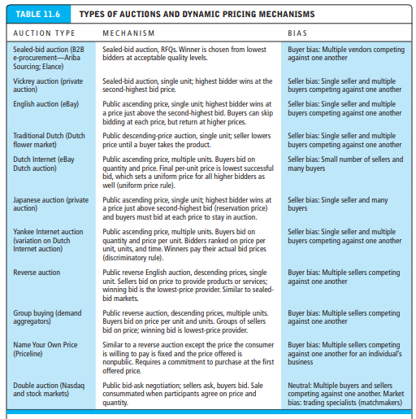
Types of Auction and Pricing Mechanisms

Slide 73
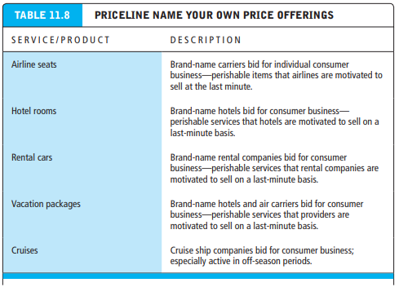
Risks and Costs of Auctions for Consumers and Businesses
Demand aggregators suppliers or market makers who group unrelated buyers into a single purchase in return for offering a lower purchase price. Prices on multiple units fall as the number of buyers increases

Slide 74
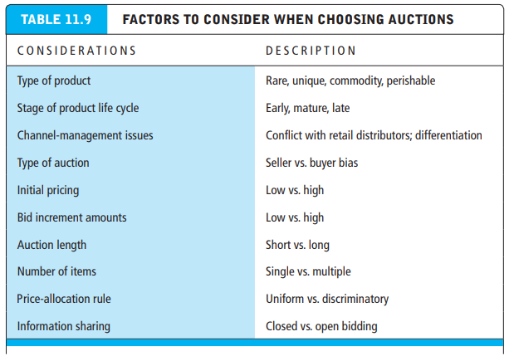
Factors when choosing auctions

Slide 75
E-Commerce Portals
Portals are the most frequently visited sites on the Web if only because they often are the first page to which many users point their browser on startup. The top portals such as Yahoo, MSN, and AOL have hundreds of millions of unique visitors worldwide each month. Web portal sites are gateways to the more than 100 billion Web pages available on the Internet. Millions of users have set Facebook as their home page, choosing to start their sessions with news from their friends

Slide 76
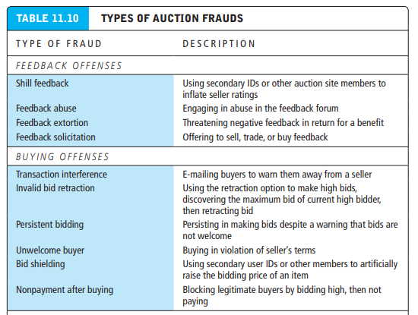
Portal – Type of Auction Frauds

Slide 77
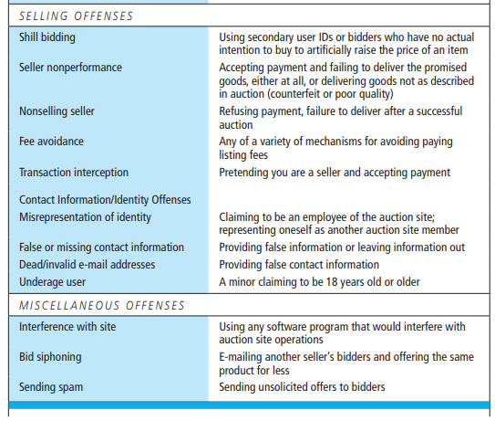
Portal – Type of Auction Frauds

Slide 78
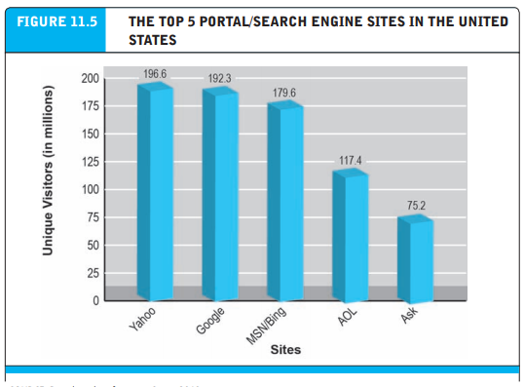
Top Portals

Slide 79
Types of Portals: General-purpose and Vertical Market
There are two primary types of portals: general-purpose portals and vertical market portals
General-purpose portals attempt to attract a very large general audience and then retain the audience on-site by providing in-depth vertical content
Vertical market portals attempt to attract highly focused, loyal audiences with a deep interest in either community or specialized content

Slide 80
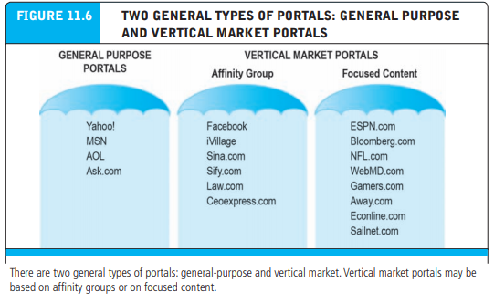
Types of Portals: General-purpose and Vertical Market

Slide 81
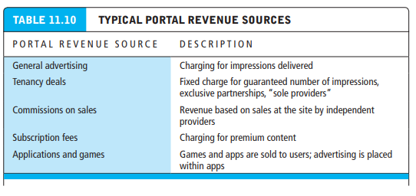
Portal Revenue Sources

Slide 82
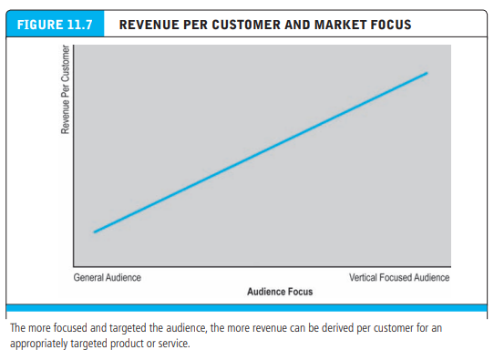
Portal Revenue Sources

Slide 83
UNIT IV E-COMMERCE IN ACTION
Chapter 12: B2B E-commerce: Supply Chain Management and Collaborative Commerce

Slide 84
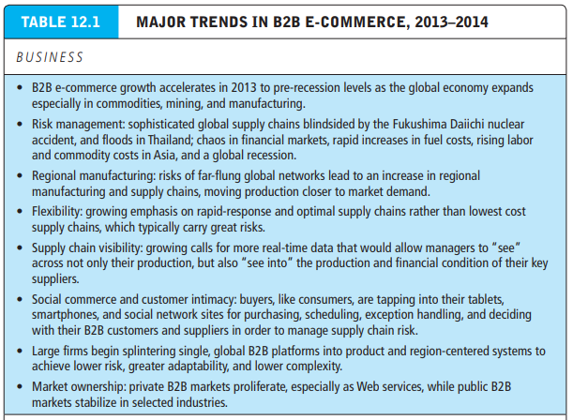
Major Trends B2B E-Commerce

Slide 85
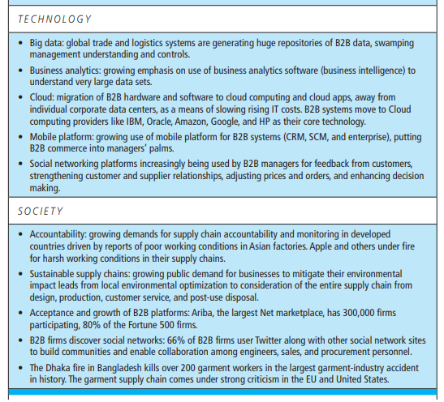
Major Trends B2B E-Commerce

Slide 86
Evolution of Technology in B2B Commerce
B2B commerce has evolved over a 35-year period through several technology-driven stages (see Figure 12.1).
The first step in the development of B2B commerce in the mid-1970s was automated order entry systems that involved the use of telephone modems to send digital orders to health care products companies such as Baxter Healthcare. Baxter, a diversified supplier of hospital supplies, placed telephone modems in its customers’ procurement offices to automate reordering from Baxter’s computerized inventory database (and to discourage reordering from competitors).
Seller-side solutions seller-biased markets that are owned by, and show only goods from, a single seller

Slide 87
Evolution of Technology in B2B Commerce
By the late 1970s, a new form of computer-to-computer communication called Electronic data interchange (EDI) emerged. We describe EDI in greater detail later in this chapter, but at this point, it is necessary only to know that EDI is a communications standard for sharing business documents such as invoices, purchase orders, shipping bills, product stocking numbers (SKUs), and settlement information among a small number of firms

Slide 88
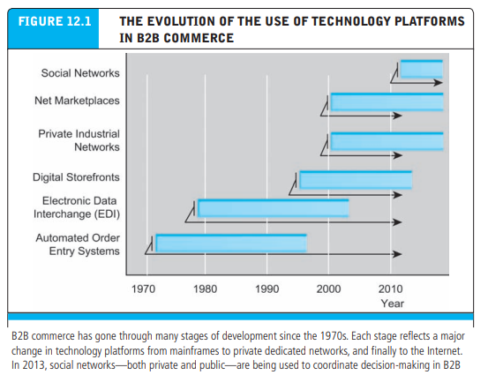
Evolution of Technology in B2B Commerce

Slide 89
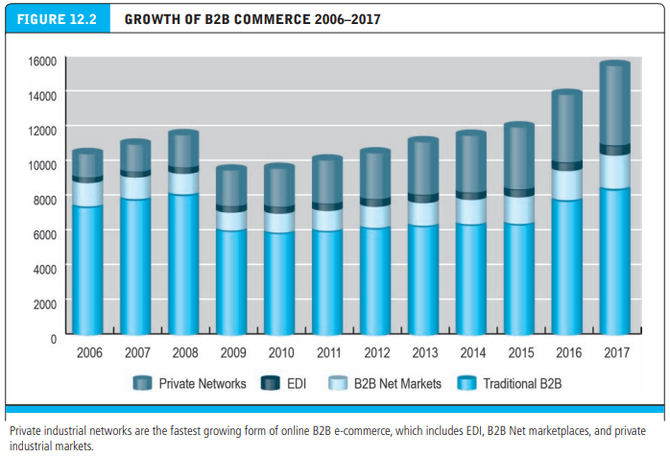
Growth of B2B Commerce

Slide 90
The Procurement Process and the Supply Chain
The subject of B2B e-commerce can be complex because there are so many ways the Internet can be used to support the exchange of goods and payments among organizations, efficient supply chains, and collaboration.
At the most basic level, B2B digital e-commerce is about changing the procurement process (how business firms purchase goods they need to produce goods they will ultimately sell to consumers) of thousands of firms across the United States and the world.

Slide 91
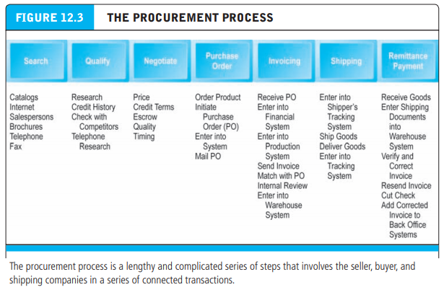
The Procurement Process and the Supply Chain

Slide 92
The Procurement Process and the Supply Chain
Types of Procurement Two distinctions are important for understanding how B2B e-commerce can improve the procurement process.
First, firms make purchases of two kinds of goods from suppliers: direct goods and indirect goods
Direct goods are goods integrally involved in the production process; for instance, when an automobile manufacturer purchases sheet steel for auto body production.
Indirect goods are all other goods not directly involved in the production process, such as office supplies and maintenance products. Often these goods are called MRO goods—products for maintenance, repair, and operations

Slide 93
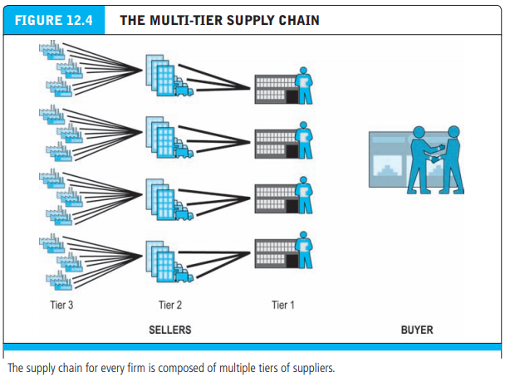
Multi Tier Supply Chain

Slide 94
Trends in Supply Chain Management and Collaborative Commerce
Supply chain management (SCM) refers to a wide variety of activities that firms and industries use to coordinate the key players in their procurement process. For the most part, today’s procurement managers still work with telephones, e-mail, fax machines, face-to-face conversations, and instinct, relying on trusted long-term suppliers for their strategic purchases of goods directly involved in the production process.
Video on Supply Chain Management

Slide 95
Electronic Data Interchange (EDI)
As noted in the previous section, B2B e-commerce did not originate with the Internet, but in fact has its roots in technologies such as EDI that were first developed in the mid-1970s and 1980s.
EDI is a broadly defined communications protocol for exchanging documents among computers using technical standards developed by the American National Standards Institute (ANSI X12 standards) and international bodies such as the United Nations (EDIFACT standards).
EDI was developed to reduce the cost, delays, and errors inherent in the manual exchanges of documents such as purchase orders, shipping documents, price lists, payments, and customer data. EDI differs from an unstructured message because its messages are organized with distinct fields for each of the important pieces of information in a commercial transaction such as transaction date, product purchased, amount, sender’s name, address, and recipient’s name.
Short View on EDI

Slide 96
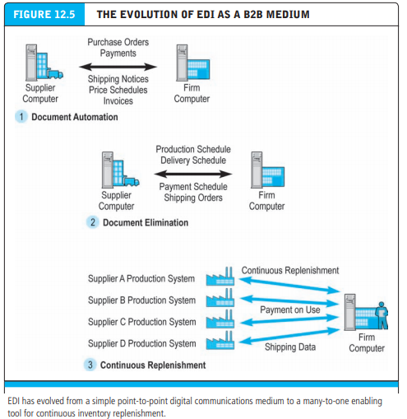
Electronic Data Interchange (EDI)

